Slide 1
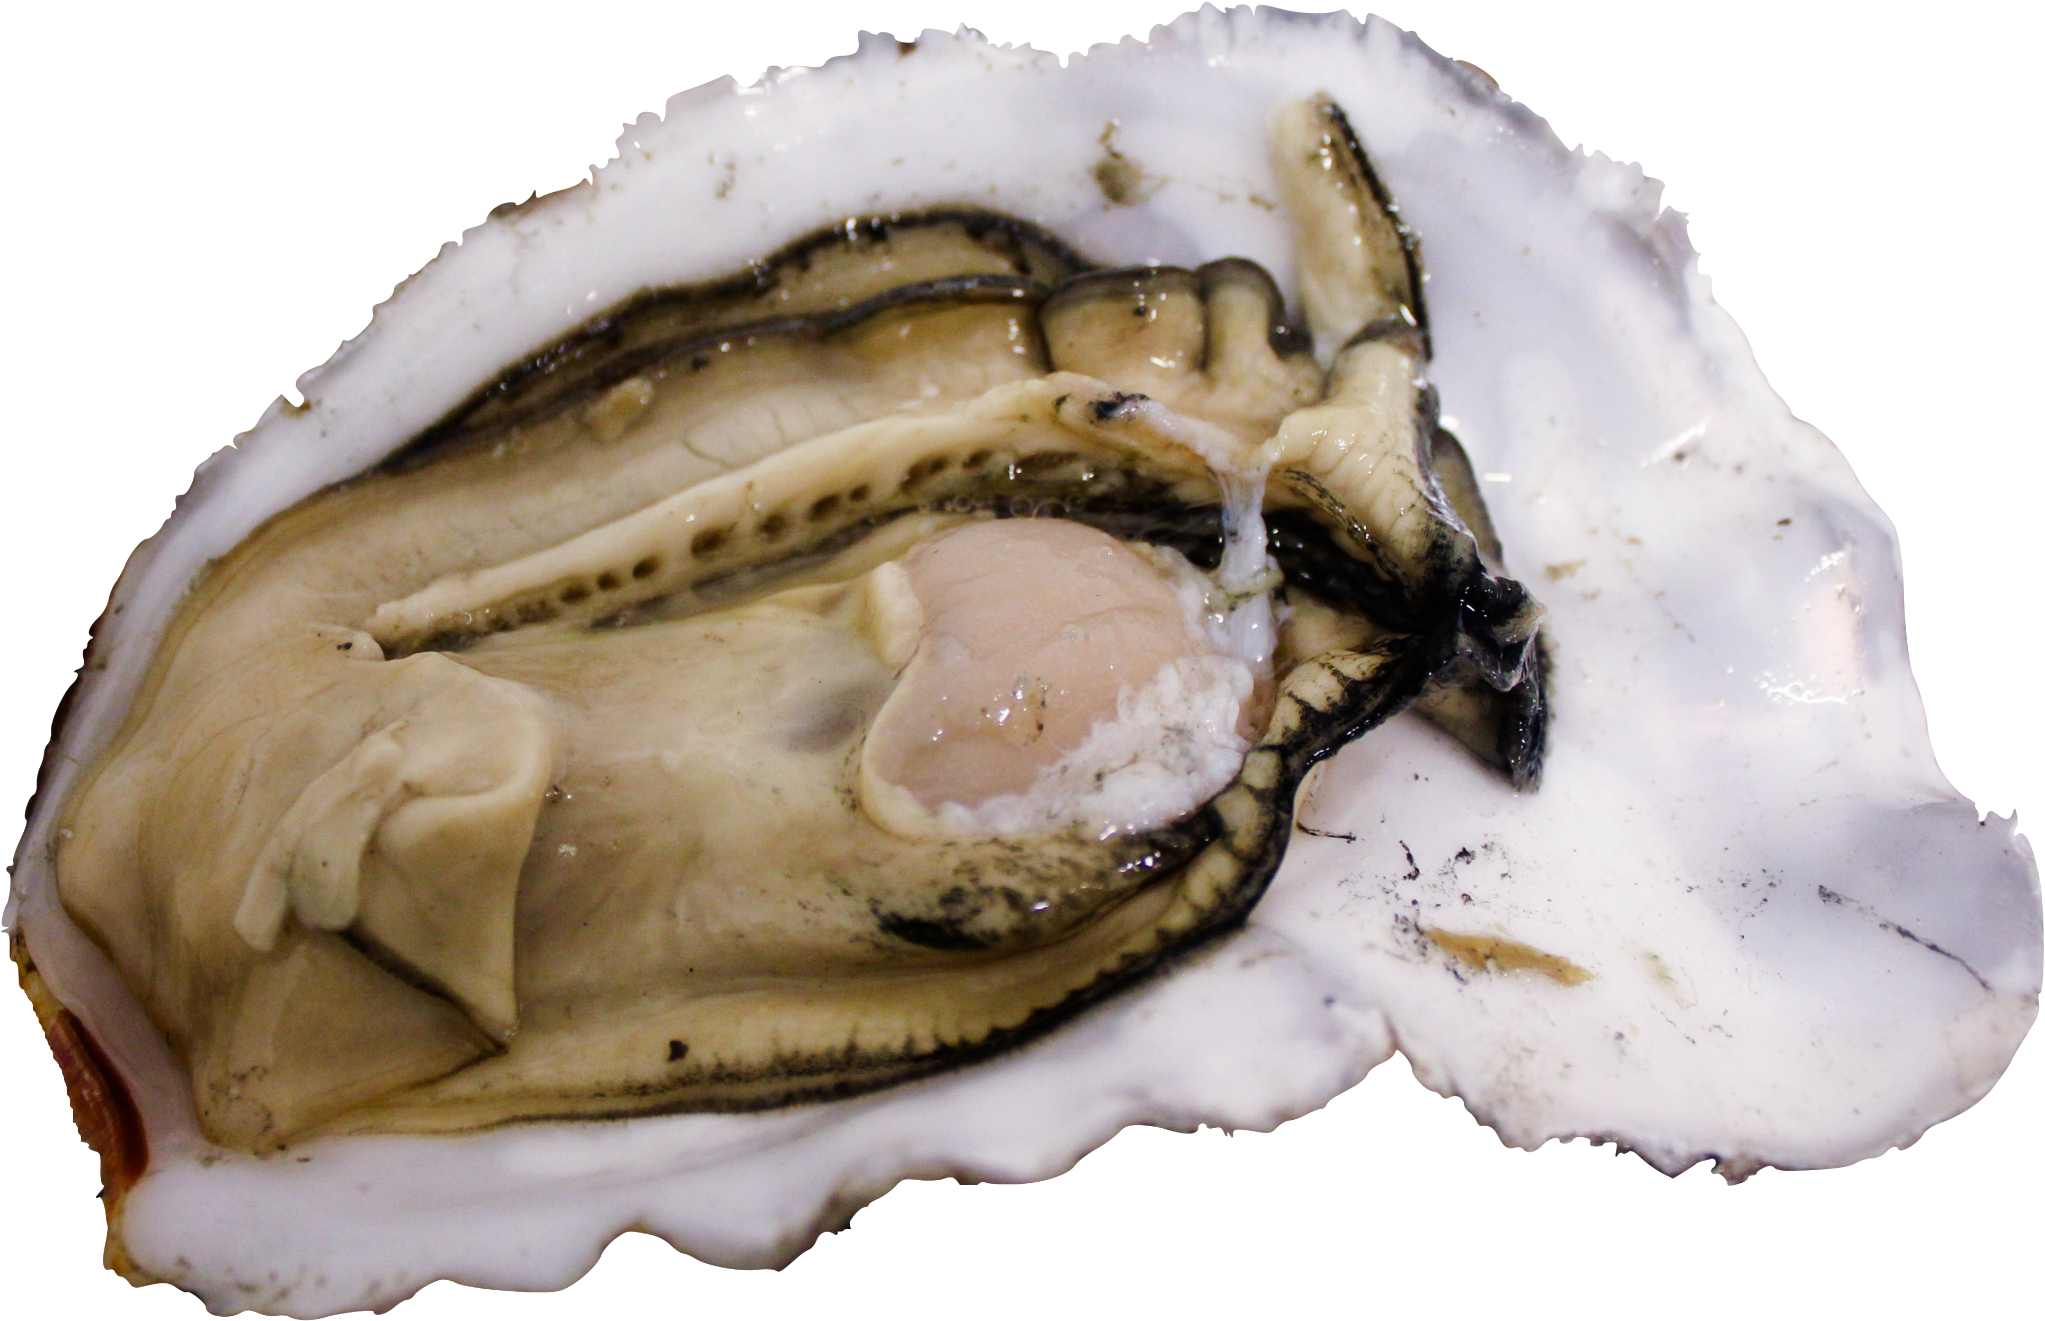

Influence of Ocean Acidification on Pacific oyster (Crassostrea gigas) DNA Methylation
Yaamini R. Venkataraman
University of Washington, Seattle
@YaaminiV
Notes:
When thinking about eco-evolutionary dynamics, oysters are good model organisms for considering epigenetic responses to environmental conditions. They live in diverse, complex habitats that mediate physiology and phenotypic plasticity. For this reason, a lot of effort has been put into understanding how adult exposure to stressful conditions can affect acclimation processes in offspring when it comes to ocean acidification.

Slide 2
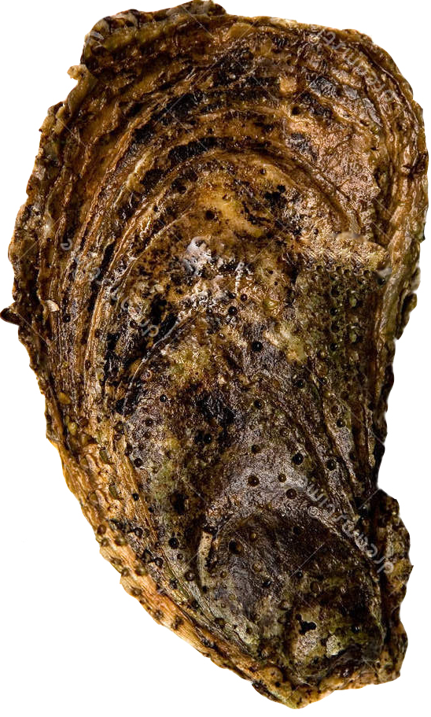
Notes:
Parental exposure can be helpful or harmful, or neutral.

Slide 3
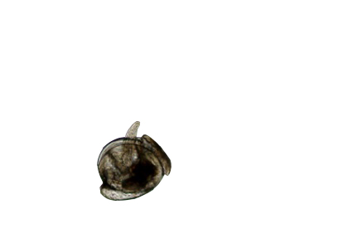
Higher survival
Bigger larvae
Fast-growing
+
Sydney rock oyster (Parker et al. 2012, 2015, 2017)
Notes:
Helpful parental exposure to low pH or high pCO2 can lead to positive carryover effects. When adult Sydney rock oysters were exposed to high pCO2 conditions, resulting larvae were faster growing in the same pCO2 conditions than larvae from parents without that prior exposure (Parker et al. 2012, 2015, 2017).

Slide 4
Higher survival
Bigger larvae
Fast-growing
Lower survival
Smaller larvae
Slow-growing
+
-
Sydney rock oyster (Parker et al. 2012, 2015, 2017)
Northern quahog and Bay scallops (Griffith and Gobler 2017)
Notes:
Harmful parental exposure leads to negative carryover effects. Larvae from adult Atlantic hard clams (Mercenaria mercenaria) and bay scallops (Argopecten irradians) developed slower when parents were reproductively conditioned in low pH conditions (pH_{T} = 7.4) (Griffith and Gobler 2017). What happens when there’s a gap between adult exposure and spawning?

Slide 5
7 Week Exposure
Low pH
(7.3)
Ambient pH
(7.8)
12 Weeks Ambient pH conditions
Spawn
Notes:
150 sib adult Pacific oysters to pH; The reason why we wanted to know about exposure before maturity is because in the wild or in the hatchery, broodstock and larvae can experience different conditions. We wanted to know if a long-removed stressor can still result in carryover effects.

Slide 6
Maternal effect on larval abundance
Ambient pH Females
Low pH Females
n = 12
n = 12
1.0
Female treatment:
X²₁ = 8.1781
p = 0.0042
0.8
*
Proportion live larvae 18hpf
0.6
0.4
0.2
Notes:
Months after our initial pH exposure ended, we’re seeing a MATERNAL EFFECT ON LARVAL ABUNDANCE
Return to ambient conditions + lag time before carryover effect was seen suggests epigenetic memory.

Slide 7
Environment
Epigenome
Ocean acidification
Change gene regulation without altering DNA sequence
Notes:
Recent studies have demonstrated that changes in the environment can affect the epigenome, or change gene regulation without altering the DNA sequence itself. One way that happens is through DNA methylation, or the addition of a methyl group onto the cytosine base of DNA.

Slide 8
Corals exhibit differential DNA methylation (Putnam et al. 2016)
Environment
Epigenome
Ocean acidification
Change gene regulation without altering DNA sequence
Notes:
For example, coral species exposed to high pCO2 conditions exhibited differences in DNA methylation, which could then be related to changes in their physiology.

Slide 9
Corals exhibit differential DNA methylation (Putnam et al. 2016)
Environment
Epigenome
Ocean acidification
Change gene regulation without altering DNA sequence
Eastern oysters show differential methylation in gonad tissue (Venkataraman et al. in prep)
Notes:
I’ve observed differential methylation in Eastern oyster reproductive tissue in response to high pCO2 conditions.

Slide 10
Does ocean acidification alter the Pacific oyster epigenome?

Slide 11
Does ocean acidification alter the Pacific oyster epigenome?
How could methylation affect potential phenotypes?
Notes:
What is the role of methylation? If yes, how?

Slide 12
Does ocean acidification alter the Pacific oyster epigenome?
How could methylation affect potential phenotypes?

Slide 13
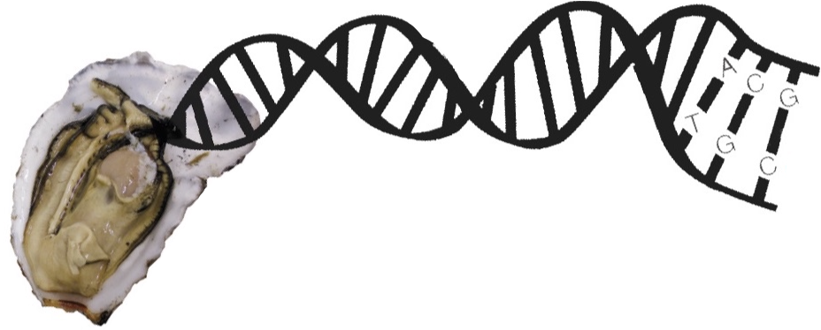
7 Week Exposure
Low pH
(7.3)
Ambient pH
(7.8)
DNA Extraction and Bisulfite Sequencing
-CH₃
Identify Differentially Methylated Loci (DML)
Notes:
Since I only observed a maternal effect, I started by pooling DNA from 2 female gonad tissues from each treatment collected after the 7 week exposure for PRELIMINARY ANALYSIS. Females were at the same reproductive stage and are siblings, so we hoped that would help reduce some interindividual variation. I performed WGBS to identify methylated regions. I then identified loci, or single cytosines next to guanines, that were 100% different between treatments using 10x coverage for each species.

Slide 14
628 DML primarily in genes
1.0
All CpGs
DML
0.8
Exons
Introns
Transposable Elements
Putative Promoters
Other
0.6
Proportion CpGs
0.4
0.2
0.0
Notes:
TE: sequences that can change position in the genome and affect gene expression
Promoter: involved in transcription of the gene

Slide 15
628 DML primarily in genes
1.0
All CpGs
DML
X²₄ = 94.784
p < 0.001
0.8
Exons
Introns
Transposable Elements
Putative Promoters
Other
0.6
Proportion CpGs
0.4
0.2
0.0
Notes:
DML concentrated in genes → evidence that DML affects gene activity

Slide 16
Does ocean acidification alter the Pacific oyster epigenome?
How could methylation affect potential phenotypes?
Notes:
Know that OA alters the pacific oyster epigenome. Can the 628 DML we found provide insight into the observed maternal effect?

Slide 17
Various biological processes affected
Notes:
Various biological processes are represented by DML

Slide 18
Various biological processes affected
Other
Protein
Metabolism
RNA
DNA
Stress Response
Stress Response
Cell Organization and Biogenesis
Development
Other
Cell Cycle
Transport
Signal Transduction
Cellular Activity
Death
Adhesion
Signal
0
2
4
6
8
10
12
14
Percent of Genes with DML
Notes:
Various biological processes are represented by DML

Slide 19
Various biological processes affected
Other
Protein
Metabolism
RNA
DNA
Stress Response
Stress Response
Cell Organization and Biogenesis
Development
Other
Cell Cycle
Transport
Signal Transduction
Cellular Activity
Death
Adhesion
Signal
0
2
4
6
8
10
12
14
Percent of Genes with DML
Notes:
Various biological processes are represented by DML

Slide 20
Various biological processes affected
Other
Protein
Metabolism
RNA
DNA
Stress Response
Stress Response
Cell Organization and Biogenesis
Development
Other
Cell Cycle
Transport
Signal Transduction
Cellular Activity
Death
Adhesion
Signal
0
2
4
6
8
10
12
14
Percent of Genes with DML
Notes:
Various biological processes are represented by DML

Slide 21
Various biological processes affected
Other
Protein
Metabolism
RNA
DNA
Stress Response
Stress Response
Cell Organization and Biogenesis
Development
Other
Cell Cycle
Transport
Signal Transduction
Cellular Activity
Death
Adhesion
Signal
0
2
4
6
8
10
12
14
Percent of Genes with DML
Notes:
Various biological processes are represented by DML

Slide 22
Various biological processes affected
Other
Protein
Metabolism
RNA
DNA
Stress Response
Stress Response
Cell Organization and Biogenesis
Development
Other
Cell Cycle
Transport
Signal Transduction
Cellular Activity
Death
Adhesion
Signal
0
2
4
6
8
10
12
14
Percent of Genes with DML
Notes:
This in itself is interesting because it shows us that there isn’t a specific biological process that’s affected when considering methylation responses to OA.

Slide 23
How could larvae be affected?
Other
Multidrug Resistance Protein
Protein
Metabolism
RNA
DNA
Stress Response
Stress Response
Cell Organization and Biogenesis
Development
Other
Cell Cycle
Transport
Signal Transduction
Cellular Activity
Death
Adhesion
Signal
0
2
4
6
8
10
12
14
Percent of Genes with DML
Notes:
Multidrug resistance protein: General stress response protein, even though it has drug in the name. Responsible for detoxification. Sydney rock oysters demonstrated downregulation of this gene when exposed to OA and warming. Could affect larvae

Slide 24
How could larvae be affected?
Other
Multidrug Resistance Protein
Ubiquitination
Protein
Metabolism
RNA
DNA
Stress Response
Stress Response
Cell Organization and Biogenesis
Development
Other
Cell Cycle
Transport
Signal Transduction
Cellular Activity
Death
Adhesion
Signal
0
2
4
6
8
10
12
14
Percent of Genes with DML
Notes:
Protein ubiquitinatino: tagging proteins to be degraded. Previous studies where oysters have been exposed to experimental ocean acidification conditions have demonstrated changes to this pathway. For example, shotgun proteomic characterization of posterior gill lamellae from adult C. gigas exposed to high pCO2 revealed increased abundance of proteins involved in ubiquitination and preventing protein degradation (Timmins-Schiffman et al., 2014). Alterations to the protein ubiquitination pathway in bivalves have been documented in response to other environmental stressors, like temperature and pollution (Flores-Nunes et al., 2015; Hofmann and Somero, 1996).
Epigenetic regulation of these genes --> affecting both adults and larave

Slide 25
How could larvae be affected?
Other
Multidrug Resistance Protein
Ubiquitination
Lipid Metabolism
Protein
Metabolism
RNA
DNA
Stress Response
Stress Response
Cell Organization and Biogenesis
Development
Other
Cell Cycle
Transport
Signal Transduction
Cellular Activity
Death
Adhesion
Signal
0
2
4
6
8
10
12
14
Percent of Genes with DML
Notes:
Lipid metabolism: crucial for maternal provisioning. Changes in gene expression related to lipid metabolism may affect maternal resources that go into developing eggs → affect larvae

Slide 26
How could larvae be affected?
Other
Multidrug Resistance Protein
Ubiquitination
Lipid Metabolism
DMTase
Protein
Metabolism
RNA
DNA
Stress Response
Stress Response
Cell Organization and Biogenesis
Development
Other
Cell Cycle
Transport
Signal Transduction
Cellular Activity
Death
Adhesion
Signal
0
2
4
6
8
10
12
14
Percent of Genes with DML
Notes:
MethyL CpG binding domain protein: proof of concept. OA is changing methylation regulatory processes

Slide 27
Environment
Epigenome
Adults Pacific oysters in low pH
628 DML, various processes affected
Notes:
Our study, which is one of the first to examine changes in DNA methylation in molluscan reproductive tissue due to low pH in Pacific oysters, identified over 600 DML, primarily within genes. Variety of processes affected, including those previously identified as being part of the oyster OA response, some related to maternal provisioning, methylation and gene expression.
Understanding how parental environment will affect larval fitness is crucial → not just during active reproduction, but the time before that may be important too. Growers need to know how broodstock experience can affect next year’s larvae, and resource managers can apply this understanding to natural populations. This research also provides a foundation for exploring avenues for organisms to acclimatize, and eventually adapt, to changing conditions.

Slide 28
Environment
Epigenome
Adults Pacific oysters in low pH
628 DML, various processes affected
Next steps
Sequence more samples
Gene-level analyses
Larval epigenetic inheritance
Compare results to similar study in Eastern oyster
Notes:
Our next steps will be to examine epigenetic inheritance in larvae and determine how methylation plays a role in larval fitness. We conducted a similar experiment with Eastern oysters, and will look at DNA methylation in Eastern oyster gonad tissue and larvae as well for cross-species comparisons.

Slide 29
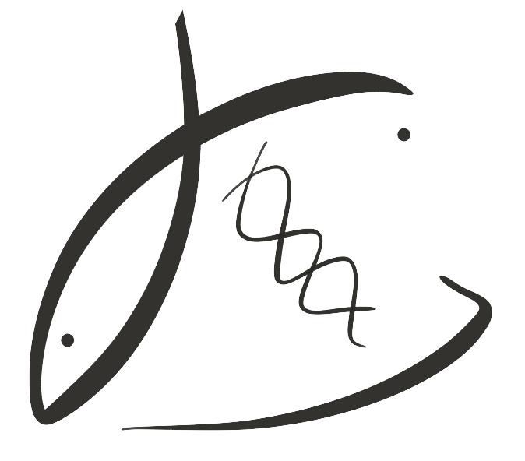




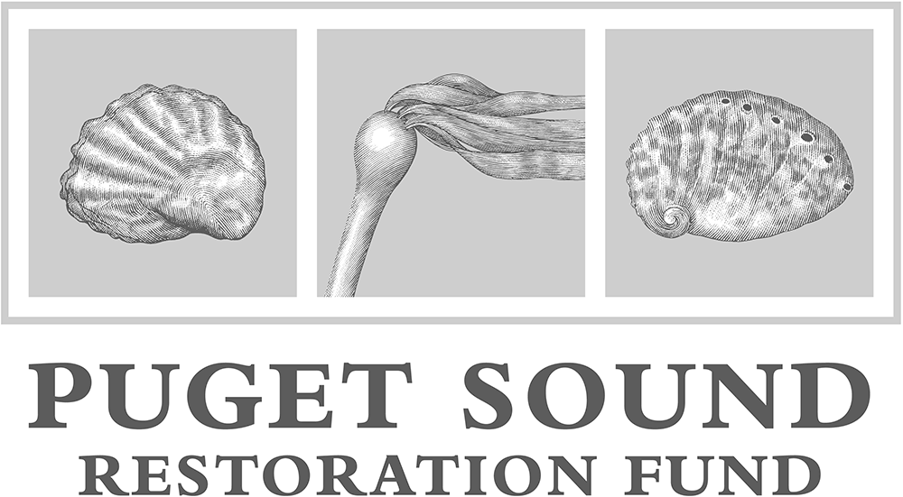
Thank you!
Steven Roberts
Brent Vadopalas
Shelly Trigg
Sam White
Laura Spencer
Grace Crandall
Kaitlyn Mitchell
Benoit Eudeline
Molly Jackson
Rhonda Elliot
Rick Goetz
Betsy Peabody
Ryan Crim
Stuart Ryan
Jade Austin
Joth Davis
Kelsey Donahue
Ashley Lockhart

Slide 30
Questions?
Yaamini R. Venkataraman
yaaminiv@uw.edu
github.com/RobertsLab/project-gigas-oa-meth

Slide 31
628 DML primarily in genes
1.0
All CpGs
DML
X²₄ = 94.784
p < 0.001
0.8
Exons
Introns
Transposable Elements
Putative Promoters
Other
0.6
Proportion CpGs
0.4
0.2
0.0
Notes:
DML concentrated in genes → evidence that DML affects gene activity

Slide 32
Various biological processes affected
Other
Protein
Metabolism
RNA
DNA
Stress Response
Stress Response
Cell Organization and Biogenesis
Development
Other
Cell Cycle
Transport
Signal Transduction
Cellular Activity
Death
Adhesion
Signal
0
2
4
6
8
10
12
14
Percent of Genes with DML
Notes:
This in itself is interesting because it shows us that there isn’t a specific biological process that’s affected when considering methylation responses to OA.

Slide 33
How could larvae be affected?
Other
Multidrug Resistance Protein
Ubiquitination
Lipid Metabolism
DMTase
Protein
Metabolism
RNA
DNA
Stress Response
Stress Response
Cell Organization and Biogenesis
Development
Other
Cell Cycle
Transport
Signal Transduction
Cellular Activity
Death
Adhesion
Signal
0
2
4
6
8
10
12
14
Percent of Genes with DML

